Slide 1
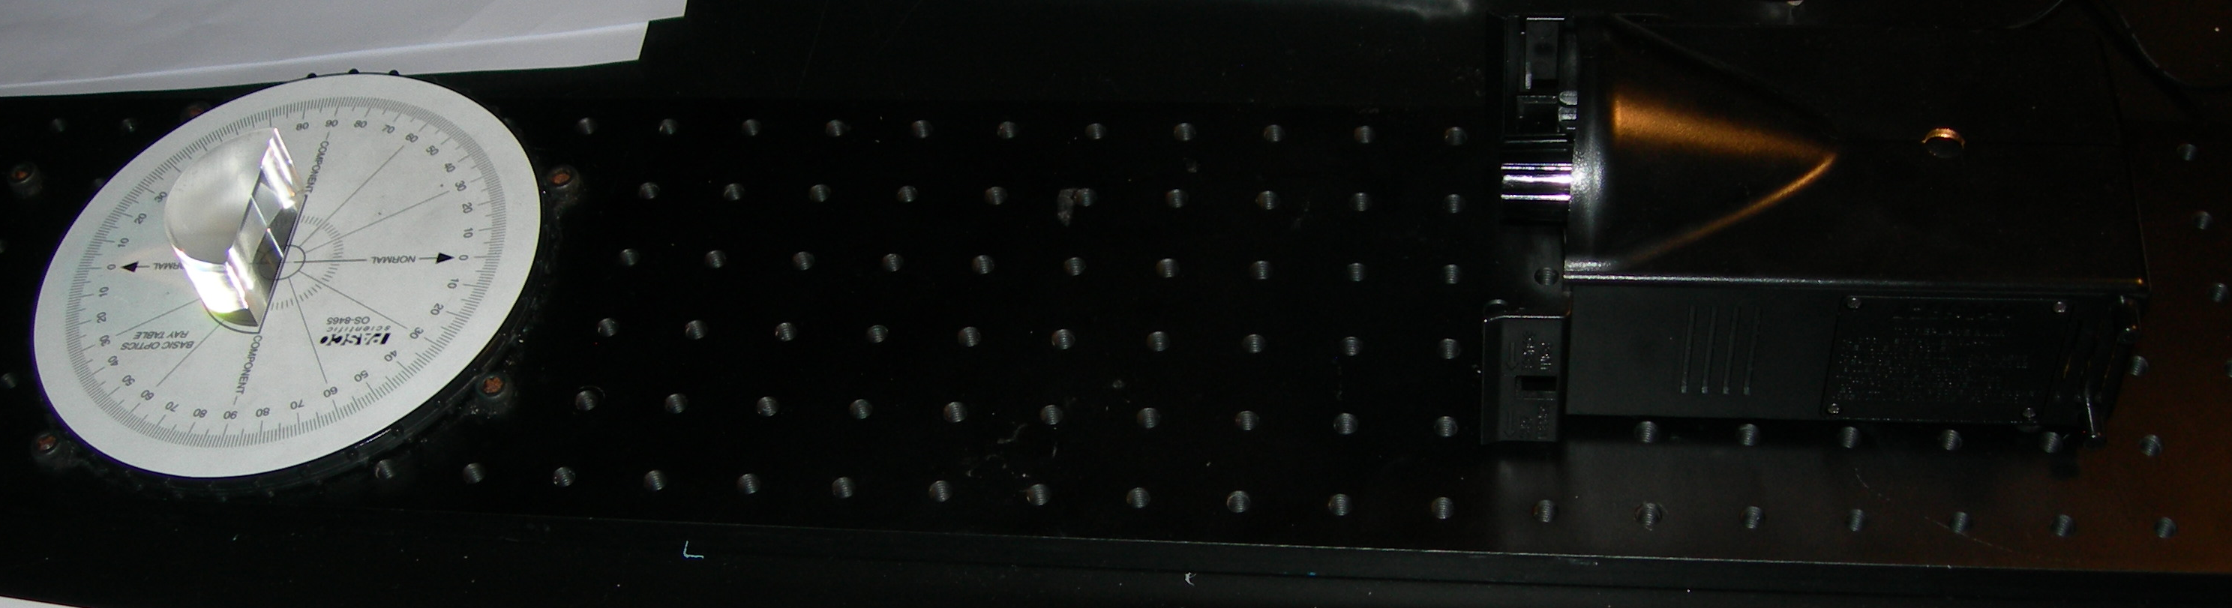
Ray Table Rotated Anti-Clockwise
Acrylic D Shaped Lens Placed in Outline of Ray Table
Light Source Positioned to Cross Centre of Ray Table

